Slide 1

Module 2: A Recap

Slide 2
Visualisations
1

Slide 3
Visualisations
In module 2, we learnt how to visualize data. In particular, we learnt:
Seaborn and matplotlib;
How to create interactive visuals;
How to use visualisations to explore data;
How to convey insights using plots.

Slide 4
Descriptive Statistics
2

Slide 5
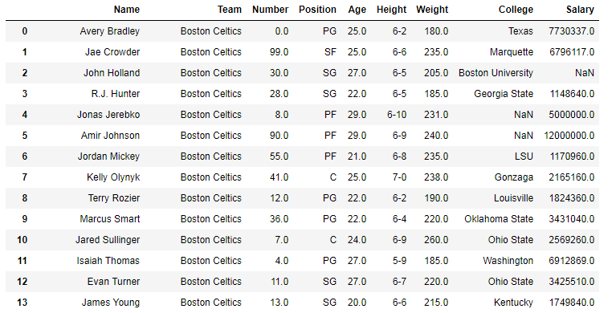
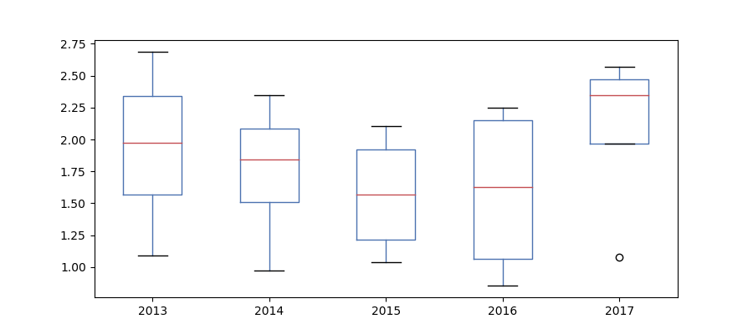
Descriptive Statistics
In module 2, we learnt tools to conduct descriptive statistics. In particular:
How to use Pandas to obtain summaries of the data;
Make quantile plots;
How to interpret distributions and make distribution plots;
How to interpret concepts such as mean, median and mode.

Slide 6
Tableau
3

Slide 7
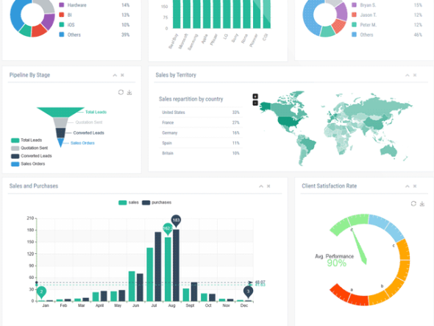

Business Intelligence
In module 2, we learnt the basics of Tableau

Slide 8
Probability Theory
4

Slide 9
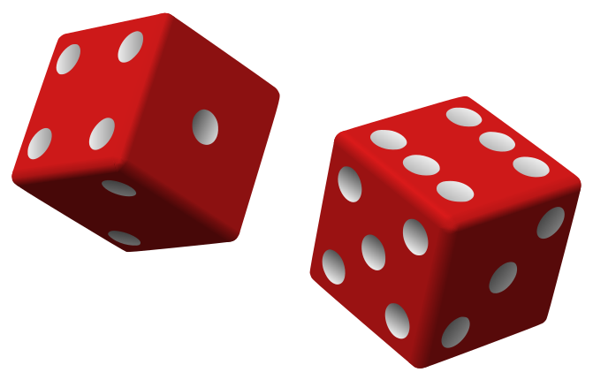
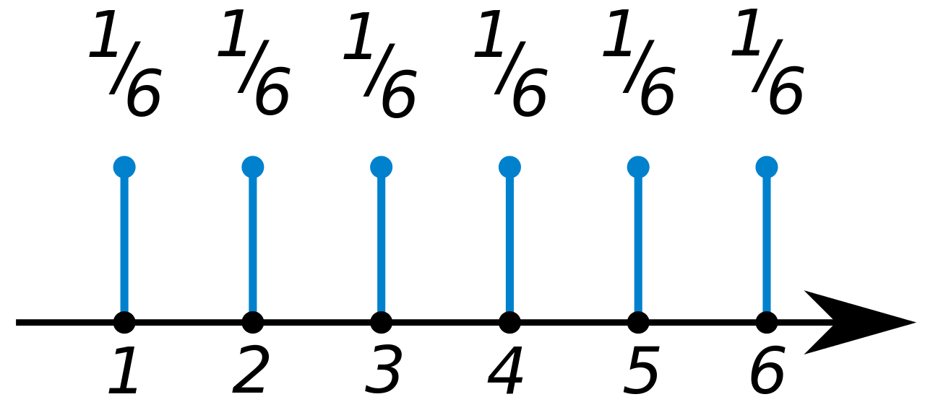
Probability Theory
We learnt some of the fundamental concepts in Probability Theory. In particular:
General rules and axioms of probability;
Central Limit Theorem;
Random variables;
Distributions.

Slide 10
Inferential Statistics
5

Slide 11
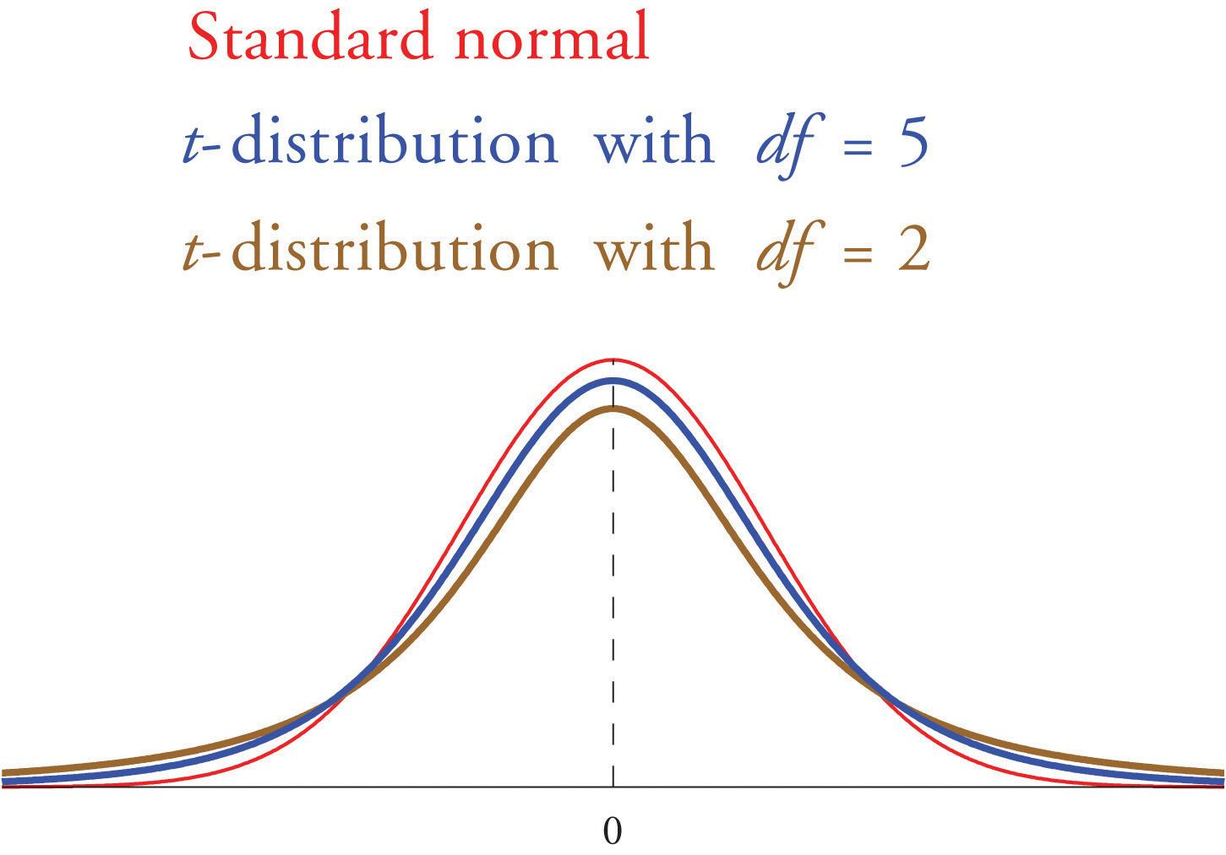
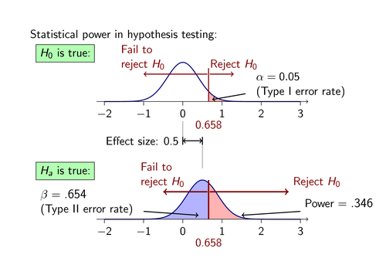
Inferential Statistics
We also learnt how to use methods from inferential statistics such as:
Confidence intervals;
Hypothesis testing and statistical significance;
The modules to perform such test such as Python’s scipy.

Slide 12
Module 3
6

Slide 13
The Present: Module 3
In Module 3 we will go one step further and look at prediction. In order to do so, we will learn various Machine Learning Algorithms.
Thus, in Module 3 - while descriptive analysis still forms the backbone of everything we’ll do - we will learn how, on the basis of historical data and descriptive analysis of this data, we may be able to say something about the future by building predictive models (i.e. ML models).

Slide 14
The Future: Module 3
Introduction to AI and Machine Learning
Feature Scaling and Feature Selection
Supervised Learning
Unsupervised Learning
NLP, Deep Learning + Other

Slide 15
The Future: Module 3
Project 5: Project on ML
Project 6: Final project! :)
Mini-presentations on Short AI/ML-Related Articles

Slide 16
The End.

